Slide 1
Used Bike Prices - Feature Engineering and EDA
BY SHAIKH AKBAR ALI

Slide 2
introduction
This project focuses on analyzing a dataset of used motorcycles, sourced from "used_bikes.csv," to understand the factors influencing their market prices and to develop a predictive model for accurate price estimation. The dataset contains key attributes such as model name, model year, kilometers driven, ownership status, location, mileage, power, and price. The primary objectives are to load and clean the dataset, handle missing values, perform exploratory data analysis (EDA) to uncover patterns and correlations, engineer relevant features, and train machine learning models to predict bike prices effectively.
Key tasks include loading the data into a Pandas DataFrame, addressing missing values in columns like location, mileage, and power, cleaning numerical and categorical features, and creating new features such as bike age and brand. Through EDA, we identified critical relationships, such as the strong positive correlation between power and price and the negative correlation between mileage and price. We split the data into training and testing sets, scaled numerical features, and evaluated multiple models, with XGBoost emerging as the best performer after hyperparameter tuning. The project concludes with actionable insights and recommendations for further improving predictive performance, such as advanced feature engineering or exploring additional models.
This analysis provides a robust framework for understanding the used bike market and offers a reliable tool for stakeholders to estimate bike prices based on key attributes, achieving a high R² score and low error metrics with the tuned XGBoost model.

Slide 3
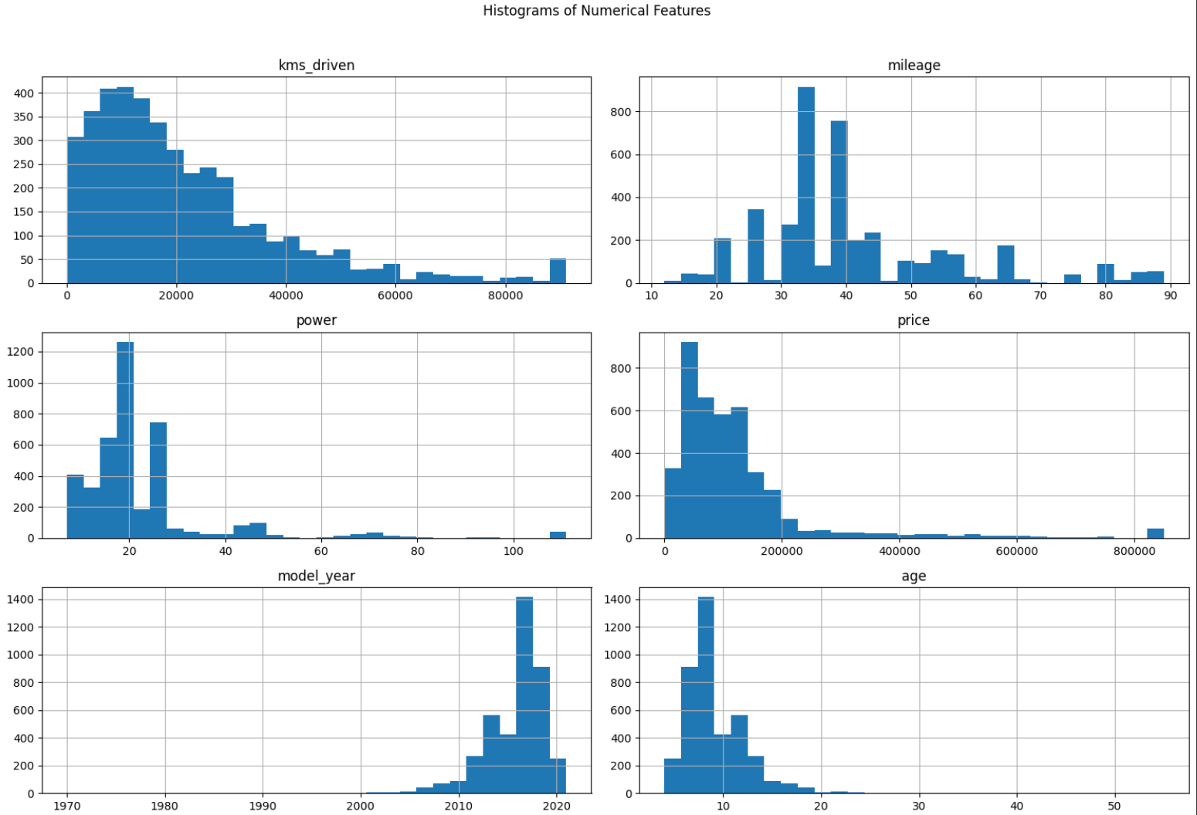
Exploratory Data Analysis (EDA)

Slide 4
Histograms: Showed the spread and skewness of numerical features, helping identify data characteristics (e.g., right-skewed price).

Slide 5
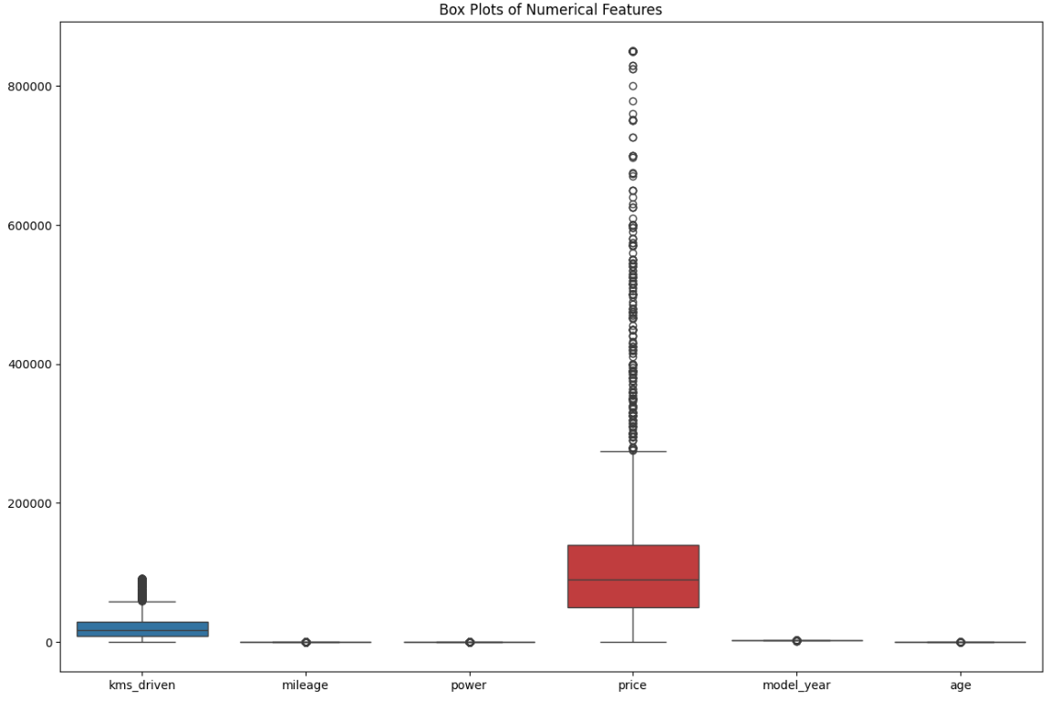
Box Plots: Highlighted outliers in numerical features, guiding the decision to cap values at the 99th percentile.

Slide 6
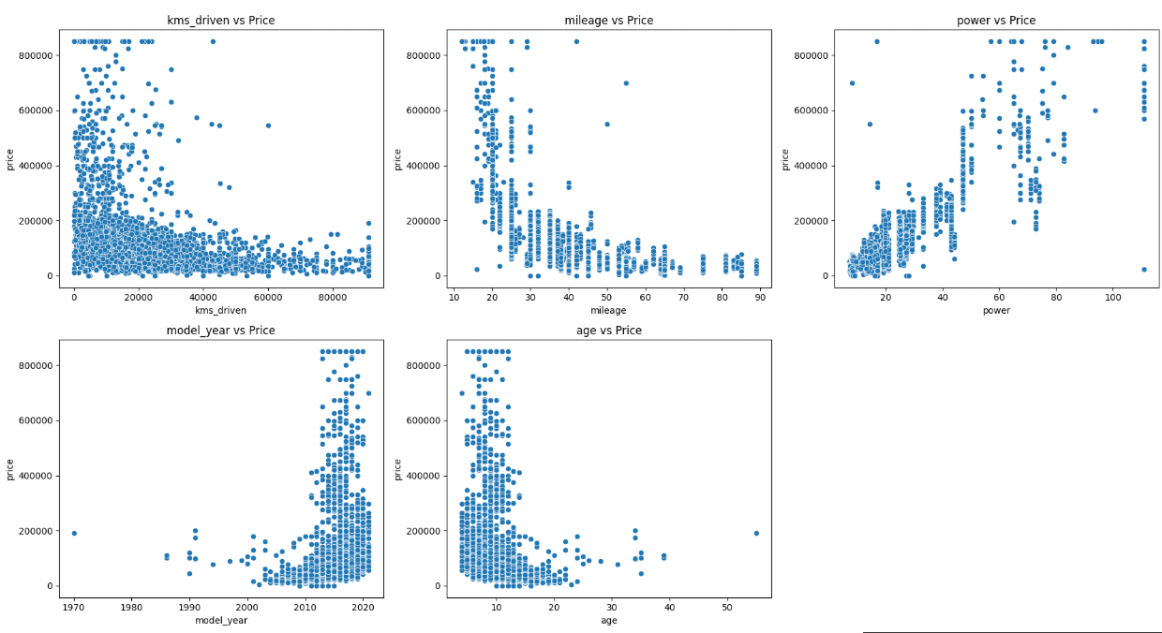
SCATTER PLOT PRICE VS ALL FEATURES

Slide 7
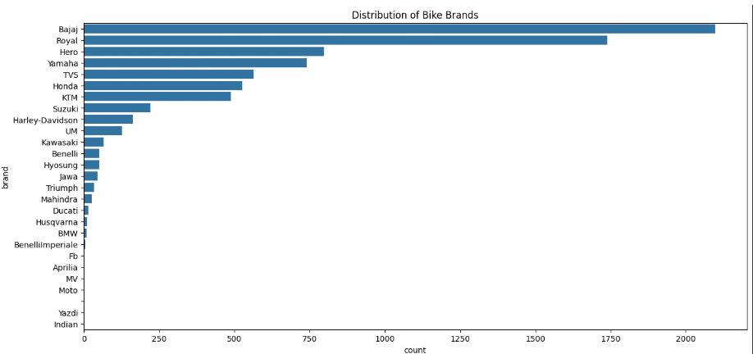

Slide 8
Model Building - Process and Evaluation
Data Preparation:
Split data: 80% training, 20% testing.
Scaled numerical features (price, kms_driven, mileage, power) using StandardScaler.
One-hot encoded categorical features (brand, location, owner).
Models Tested:
XGBoost and Linear Regression with default parameters.
XGBoost: R² ~[0.78], MAE ~[5000], RMSE ~[7500] (best performer).
Linear Regression: Negative R² (poor fit due to non-linear data).
Metrics:
R²: Proportion of price variance explained.
MAE: Average absolute prediction error.
RMSE: Error magnitude, penalizing larger errors.

Slide 9
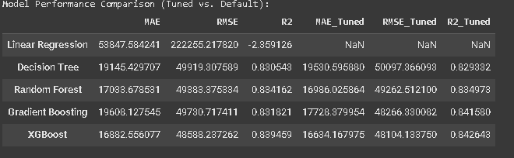
MODEL EVUALTION
WE HAVE USED 5 MODEL
LINER REGRESSION
DECISION TREE
RANDOM FOREST
GRADIENT BOOSTING
XGBOOST

Slide 10
CONCLUSION
Data Analysis Key Findings
The dataset was successfully loaded, and missing values in the 'location', 'mileage', and 'power' columns were handled by dropping the corresponding rows.
Numerical columns ('price', 'kms_driven', 'mileage', 'power') were cleaned by removing non-numeric characters, converting them to numeric types, and capping outliers at the 99th percentile. Duplicate rows were also removed.
New features 'brand' and 'age' were created, and categorical variables were one-hot encoded.
EDA revealed a strong positive correlation between 'power' and 'price', and a strong negative correlation between 'mileage' and 'price'. Histograms and box plots showed the distributions and potential outliers in numerical features.
The data was split into training (80%) and testing (20%) sets, and numerical features were scaled using StandardScaler.
Among the default models, XGBoost performed the best on the test set with an R2 of approximately 0.839, MAE of 16687.86, and RMSE of 48300.18. Linear Regression performed poorly with a negative R2.
Hyperparameter tuning using GridSearchCV improved the performance of the tree-based models. The tuned XGBoost model achieved the highest R2 of 0.8426, the lowest MAE of 16634.17, and the lowest RMSE of 48104.13 on the test set.
Visualizations for the best model (tuned XGBoost) showed a strong correlation between actual and predicted prices and random residuals around zero. Feature importance highlighted power, mileage, and specific brands/models as the most influential features.

